Slide 1





Liberty Middle School
2024
SOCCER
CLUB

Slide 2

EXPECTATIONS
Soccer Club
You are student-athletes…. emphasis on student first. You are representing Liberty by association with our team and will be expected to represent yourself, your teammates, and your school in a positive manner.
You must maintain passing grades to participate, 4 out of 5 academic classes for 8th grade & 3 out 4 for 6th and 7th grade for the current semester.
Be respectful to classmates, teachers, school personnel, parents, opposing teams, referees, and members of our school community.
Representing your school is different from representing your club… not saying better, just different. A different sense of pride with putting on a jersey with those that you go to school with.

Slide 3
TEAM INFO
Teams Participating: DMS, HMS, LSMS, LMMS, OMS, PGMS, RMS, SFMS, VCMS
Three Teams:
  A team
  B team
  C team
Tryouts: March 5th & 6th, 7-8:30am
During the season, practices will be on Tuesday & Wednesday mornings from 7:30-8:30.
STUDENTS MUST HAVE A PHYSICAL UPLOADED TO DRAGONFLY IN ORDER TO PARTICIPATE IN SOCCER CLUB
DragonFly instructions link: https://www.forsyth.k12.ga.us/Page/55111
FEES: $60

Slide 4

SCHEDULE INFO
Games will be on Saturday’s in March starting as early as 8:00am or starting as late as 2:15pm.
Two 25-minute halves, gate fee of $3 for spectators.
If you are on a travel team, then once our schedule is finalized make sure there are no conflicts, or you have a plan if there are.

Slide 5
There will be some flexibility with moving from one roster to another based on play, availability, injuries, grades, or other.
Playing time is not guaranteed, I will do everything I can to play all players, but it may not be equal. Players are expected to attend practice which can also impact playing time
  Competitive team (A Team) will have three scheduled games and then a “playoff” vs corresponding seed in the other division
  Rec Team (B Team) will have three scheduled games, no playoff game.
TEAM BREAKDOWN
A Team & B Team Rosters

Slide 6
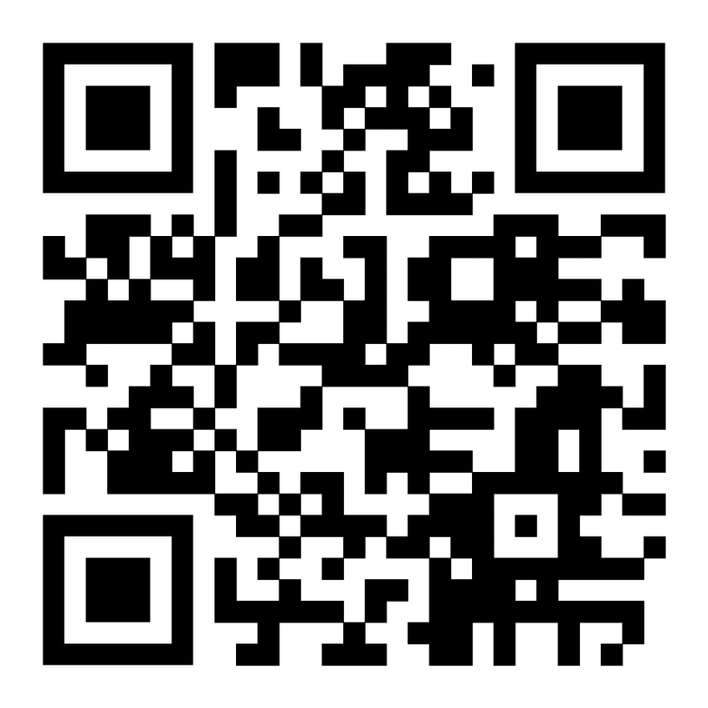
QR CODE

Slide 7

Soccer Club
ANY
QUESTIONS?

